Slide 1
Dr. Derek Cabrera
TED Talk on “Thinking”

Slide 2

How thinking works?
Does “being good” at school transfer to being good at life?

Slide 3

Types of thinking
Critical
Creative
Systems
Scientific
Interdisciplinary
Emotional Intelligence/Prosocial Thinking

Slide 4
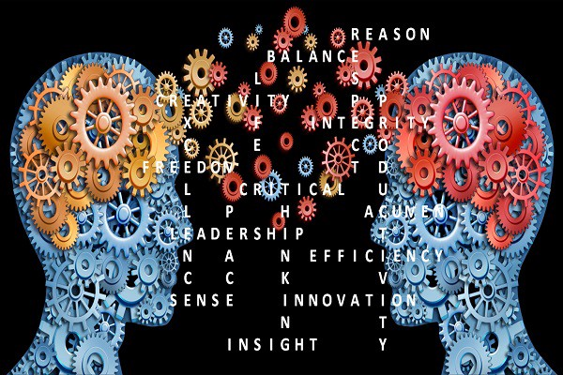
Why is thinking so important?

Slide 5
The problem with instructions…
What is the problem?
Why is it a problem?
How can we solve the problem?

Slide 6
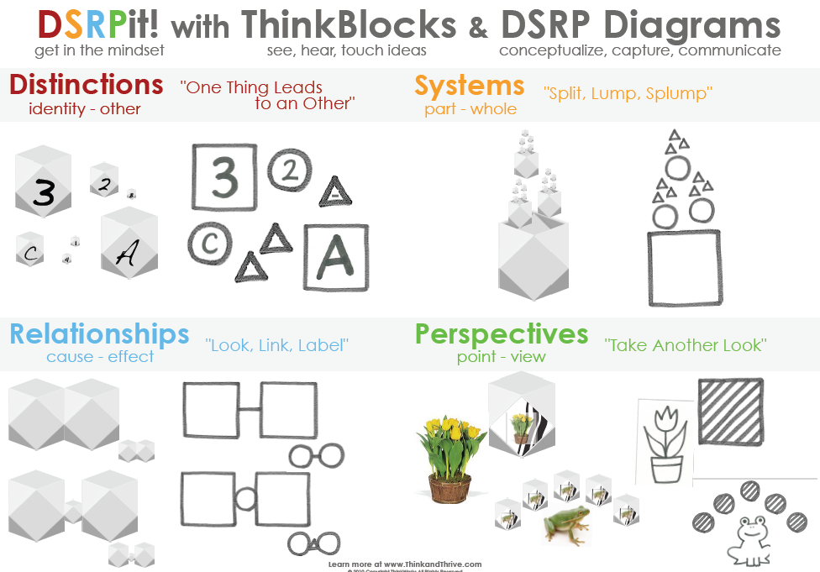
Thinking Skills…
Distinctions
Systems
Relationships
Perspectives

Slide 7
Thinking Skills…DSRP Framework
D
S
R
P
Distinctions (identity and other): What is __? What is not __?
Systems (part and whole): Does __ have parts? Can you think of __ as a part?
Relationships (inter and action): Is __ related to __? Can you think of __ as a relationship?
Perspectives (point and view): From the perspective of __, [insert question]? Can you think about __ from a different perspective?

Slide 8
TED Video!
https://www.youtube.com/watch?v=dUqRTWCdXt4

